Slide 1
TRUST vs PRIVACY
CYS 121 INFORMATION SYSTEM SECURITY

Slide 2
Trust and Privacy
Privacy :- entity’s ability to control the availability and exposure of information about itself
  An entity’s example includes an organization or software
Privacy Problem
  Consider computer-based interactions
    From a simple transaction to a complex collaboration
  Interactions always involve dissemination of private data
    It is voluntary, “pseudo-voluntary,” or compulsory
      Compulsory - e.g., required by law
  Threats of privacy violations result in lower trust
  Lower trust leads to isolation and lack of collaboration

Slide 3
6. Trust and Privacy cont
Thus, privacy and trust are closely related
  Privacy-trust tradeoff: Entity can trade privacy for a corresponding gain in its partners’ trust in it
  The scope of an entity’s privacy disclosure should be proportional to the benefits expected from the interaction
    As in social interactions
    E.g.: a customer applying for a mortgage must reveal much more personal data than someone buying a book
Trust must be established before a privacy disclosure
  Data – provide quality an integrity
  End-to-end communication – sender authentication, message integrity
  Network routing algorithms – deal with malicious peers, intruders, security attacks

Slide 4
Optimize degree of privacy traded to gain trust
  Disclose minimum needed for gaining partner’s necessary trust level
To optimize, need privacy & trust measures
Once measures available:
  Automate evaluations of the privacy loss and trust gain
  Quantify the trade-off
  Optimize it
Privacy-for-trust trading requires privacy guarantees for further dissemination of private info
  Disclosing party needs satisfactory limitations on further dissemination (or the lack of thereof) of traded private information
  E.g., needs partner’s solid privacy policies
    Merely perceived danger of a partner’s privacy violation can make the disclosing party reluctant to enter into a partnership
      E.g., a user who learns that an ISP has carelessly revealed any customer’s email will look for another ISP

Slide 5
Three Types of Trading Information for Trust
  Symmetric disclosing:
    Initial degree of trust / stepwise trust growth / establishes mutual „full” trust
    Trades info for trust
  Symmetric preserving: (from distrust to trust)
    Initial distrust / no stepwise trust growth / establishes mutual „full” trust(this is were you don’t have legal evidence about the other organisation/ entitety or software but you trust them)
    No trading of info for trust
  Asymmetric:
    Initial „full” trust of Weaker into Stronger and no trust of Stronger into Weaker / stepwise trust growth / establishes „full” trust of Stronger into Weaker e.g banks
    Trades private info for trust

Slide 6
Asymmetric Trust Negotiation
Privacy-Trust Tradeoff: Trading Privacy Loss for Trust Gain
We’re focusing on asymmetric trust negotiations:
The weaker party trades a (degree of) privacy loss for (a degree of) a trust gain as perceived by the stronger party

Slide 7
Proposed Approach to Trading privacy for trust [Zhong and Bhargava, Purdue]
Formulate the privacy-trust tradeoff problem
Estimate privacy loss due to disclosing a set of credentials
Estimate trust gain due to disclosing a set of credentials
Develop algorithms that minimize privacy loss for required trust gain
  Because nobody likes loosing more privacy than necessary

Slide 8
A. Formulate Tradeoff Problem
Set of private attributes that user wants to conceal or hide (Universal set)
Set of credentials
  Subset of revealed credentials R
  Subset of unrevealed credentials U (NC is being derived from U)
Choose a subset of credentials NC from U such that:
  NC satisfies the requirements for trust building
  PrivacyLoss(NC+R) – PrivacyLoss(R) is minimized

Slide 9
Steps B – D of the Approach
Estimate privacy loss due to disclosing a set of credentials
  Requires defining privacy metrics
Estimate trust gain due to disclosing a set of credentials
  Requires defining trust metrics
Develop algorithms that minimize privacy loss for required trust gain
  Includes prototyping and experimentation

Slide 10
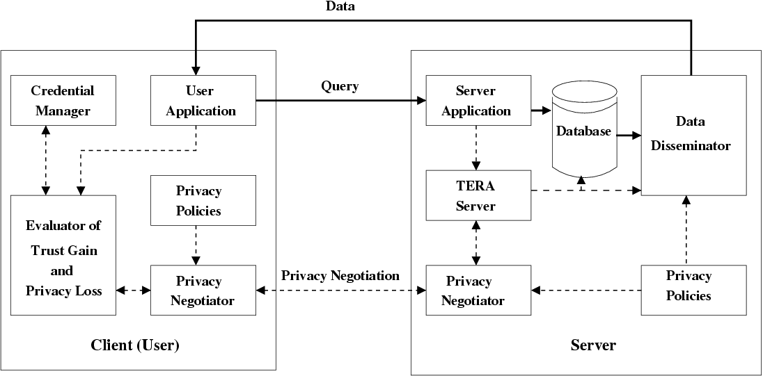
PRETTY Prototype for Experimental Studies
(4)
(1)
[2c2]
(2)
(3) User Role
[2a]
[2b] [2d]
[2c1]
(<nr>) – unconditional path
[<nr>]– conditional path
TERA = Trust-Enhanced Role Assignment

Slide 11
Information Flow in PRETTY
User application sends query to server application.
Server application sends user information to TERA server for trust evaluation and role assignment.
  If a higher trust level is required for query, TERA server sends the request for more user’s credentials to privacy negotiator.
  Based on server’s privacy policies and the credential requirements, privacy negotiator interacts with user’s privacy negotiator to build a higher level of trust.
  Trust gain and privacy loss evaluator selects credentials that will increase trust to the required level with the least privacy loss. Calculation considers credential requirements and credentials disclosed in previous interactions.
  According to privacy policies and calculated privacy loss, user’s privacy negotiator decides whether or not to supply credentials to the server.
Once trust level meets the minimum requirements, appropriate roles are assigned to user for execution of his query.
Based on query results, user’s trust level and privacy polices, data disseminator determines: (i) whether to distort data and if so to what degree, and (ii) what privacy enforcement metadata should be associated with it.

Slide 12
8. Using Entropy to Trade Privacy for Trust

Slide 13
Problem motivation
Privacy and trust form an adversarial relationship
  Internet users worry about revealing personal data. This fear held back $15 billion in online revenue in 2001
  Users have to provide digital credentials that contain private information in order to build trust in open environments like Internet.
Research is needed to quantify the tradeoff between privacy and trust

Slide 14
Subproblems
How much privacy is lost by disclosing a piece of credential?
How much does a user benefit from having a higher level of trust?
How much privacy a user is willing to sacrifice for a certain amount of trust gain?

Slide 15
Proposed approach
Formulate the privacy-trust tradeoff problem
Design metrics and algorithms to evaluate the privacy loss. We consider:
  Information receiver
  Information usage
  Information disclosed in the past
Estimate trust gain due to disclosing a set of credentials
Develop mechanisms empowering users to trade trust for privacy.
Design prototype and conduct experimental study

Slide 16
Formulation of tradeoff problem (1)
Set of private attributes that user wants to conceal
Set of credentials
  R(i): subset of credentials revealed to receiver i
  U(i): credentials unrevealed to receiver i
Credential set with minimal privacy loss
  A subset of credentials NC from U (i)
  NC satisfies the requirements for trust building
  PrivacyLoss(NC∪R(i)) – PrivacyLoss(R(i))) is minimized

Slide 17
Formulation of tradeoff problem (2)
Decision problem:
  Decide whether trade trust for privacy or not
  Determine minimal privacy damage
    Minimal privacy damage is a function of minimal privacy loss, information usage and trustworthiness of information receiver.
  Compute trust gain
  Trade privacy for trust if trust gain > minimal privacy damage
Selection problem:
  Choose credential set with minimal privacy loss

Slide 18
Two types of privacy loss (1)
Query-independent privacy loss
  User determines her private attributes
  Query-independent loss characterizes how helpful provided credentials for an adversarial to determine the probability density or probability mass function of a private attribute.

Slide 19
Two types of privacy loss (2)
Query-dependent privacy loss
  User determines a set of potential queries Q that she is reluctant to answer
  Provided credentials reveal information of attribute set A. Q is a function of A.
  Query-dependent loss characterizes how helpful provided credentials for an adversarial to determine the probability density or probability mass function of Q.

Slide 20
Observation 1
Privacy loss is affected by the order of disclosure
Example:
  Private attribute
    age
  Potential queries:
    (Q1) Is Alice an elementary school student?
    (Q2) Is Alice older than 50 to join a silver insurance plan?
  Credentials
    (C1) Driver license
    (C2) Purdue undergraduate student ID

Slide 21
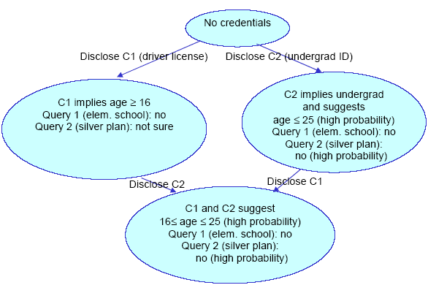
Example (1)

Slide 22
Example (2)
C1 → C2
  Disclosing C1
    low query-independent loss (wide range for age)
    100% loss for Query 1 (elem. school student)
    low loss for Query 2 (silver plan)
  Disclosing C2
    high query-independent loss (narrow range for age)
    zero loss for Query 1 (because privacy was lost by disclosing license)
    high loss for Query 2 (“not sure” → “no - high probability”
C2 → C1
  Disclosing C2
    low query-independent loss (wide range for age)
    100% loss for Query 1 (elem. school student)
    high loss for Query 2 (silver plan)
  Disclosing C1
    high query-independent loss (narrow range of age)
    zero loss for Query 1 (because privacy was lost by disclosing ID)
    zero loss for Query 2

Slide 23
Entropy-based privacy loss
Entropy measures the randomness, or uncertainty, in private data.
When an adversarial gains more information, entropy decreases
The difference shows how much information has been leaked
Conditional probability is needed for entropy evaluation
  Bayesian networks, kernel density estimation or subjective estimation can be adopted

Slide 24
Estimate trust gain
Increasing trust level
  Adopt research on trust establishment and management
Benefit function TB(trust_level)
  Provided by service provider or derived from user’s utility function
Trust gain
  TB(trust_level_{new}) - TB(tust_level_{prev})

Slide 25
Conclusion
This research addresses the tradeoff issues between privacy and trust.
Tradeoff problems are formally defined.
An entropy-based approach is proposed to estimate privacy loss.
A prototype is under development for experimental study.

Slide 26
A Mechanism for
Privacy-Preserving Data Dissemination

Slide 27
P2D2 - Mechanism for Privacy-Preserving Data Dissemination
Outline
  Introduction
    1.1) Interactions and Trust
    1.2) Building Trust
    1.3) Trading Weaker Partner’s Privacy Loss for Stronger Partner’s Trust Gain
    1.4) Privacy-Trust Tradeoff and Dissemination of Private Data
    1.5) Recognition of Need for Privacy Guarantees
  Problem and Challenges
    2.1) The Problem
    2.2) Trust Model
    2.3) Challenges
  3) Proposed Approach: Privacy-Preserving Data Dissemination (P2D2) Mechanism
    3.1) Self-descriptive Bundles
    3.2) Apoptosis of Bundles
    3.3) Context-sensitive Evaporation of Bundles
  4) Prototype Implementation
  5) Conclusions
  6) Future Work

Slide 28
1) Introduction
1.1) Interactions and Trust
Trust – new paradigm of security
  Replaces/enhances CIA (confid./integr./availab.)
Adequate degree of trust required in interactions
  In social or computer-based interactions:
    From a simple transaction to a complex collaboration
  Must build up trust w.r.t. interaction partners
    Human or artificial partners
    Offline or online
We focus on asymmetric trust relationships:
One partner is “weaker,” another is “stronger”
  Ignoring “same-strength” partners:
    Individual to individual, most B2B,

Slide 29
1.2) Building Trust (1) a) Building Trust By Weaker Partners
Means of building trust by weaker partner in his strongeer (often institutional) partner (offline and online):
  Ask around
    Family, friends, co-workers, …
  Check partner’s history and stated philosophy
    Accomplishments, failures and associated recoveries, …
    Mission, goals, policies (incl. privacy policies), …
  Observe partner’s behavior
    Trustworthy or not, stable or not, …
    Problem: Needs time for a fair judgment
  Check reputation databases
    Better Business Bureau, consumer advocacy groups, …
  Verify partner’s credentials
    Certificates and awards, memberships in trust-building organizations (e.g., BBB), …
  Protect yourself against partner’s misbehavior
    Trusted third-party, security deposit, prepayment,, buying insurance, …

Slide 30
1.2) Building Trust (2) b) Building Trust by Stronger Partners
Means of building trust by stronger partner in her weaker (often individual) partner (offline and online):
  Business asks customer for a payment for goods or services
  Bank asks for private information
  Mortgage broker checks applicant’s credit history
  Authorization subsystem on a computer observes partner’s behavior
    Trustworthy or not, stable or not, …
    Problem: Needs time for a fair judgment
  Computerized trading system checks reputation databases
    e-Bay, PayPal, …
  Computer system verifies user’s digital credentials
    Passwords, magnetic and chip cards, biometrics, …
  Business protects itself against customer’s misbehavior
    Trusted third-party, security deposit, prepayment,, buying insurance, …

Slide 31
1.3) Trading Weaker Partner’s Privacy Loss for Stronger Partner’s Trust Gain
In all examples of Building Trust by Stronger Partners but the first (payments):
Weaker partner trades his privacy loss for his trust gain as perceived by stronger partner
Approach to trading privacy for trust:
[Zhong and Bhargava, Purdue]
  Formalize the privacy-trust tradeoff problem
  Estimate privacy loss due to disclosing a credential set
  Estimate trust gain due to disclosing a credential set
  Develop algorithms that minimize privacy loss for required trust gain
    Bec. nobody likes loosing more privacy than necessary

Slide 32
1.4) Privacy-Trust Tradeoff and
Dissemination of Private Data
Dissemination of private data
  Related to trading privacy for trust:
    Examples above
  Not related to trading privacy for trust:
    Medical records
    Research data
    Tax returns
    …
Private data dissemination can be:
  Voluntary
    When there’s a sufficient competition for services or goods
  Pseudo-voluntary
    Free to decline… and loose service
      E.g. a monopoly or demand exceeding supply)
  Mandatory
    Required by law, policies, bylaws, rules, etc.

Slide 33
Dissemination of Private Data is Critical
Reasons:
  Fears/threats of privacy violations reduce trust
  Reduced trust leads to restrictions on interactions
    In the extreme:
    refraining from interactions, even self-imposed isolation
    Very high social costs of lost (offline and online) interaction opportunities
      Lost business transactions, opportunities
      Lost research collaborations
      Lost social interactions
      …
=> Without privacy guarantees, pervasive computing will
never be realized
    People will avoid interactions with pervasive devices / systems
      Fear of opportunistic sensor networks self-organized by electronic devices around them – can help or harm people in their midst

Slide 34
1.5) Recognition of Need for Privacy Guarantees (1)
By individuals [Ackerman et al. ‘99]
  99% unwilling to reveal their SSN
  18% unwilling to reveal their… favorite TV show
By businesses
  Online consumers worrying about revealing personal data
  held back $15 billion in online revenue in 2001
By Federal government
  Privacy Act of 1974 for Federal agencies
  Health Insurance Portability and Accountability Act of 1996 (HIPAA)

Slide 35
3.1) Self-descriptive Bundles
Comprehensive metadata include:
  owner’s privacy preferences
  owner’s contact information
  guardian’s privacy policies
  metadata access conditions
  enforcement specifications
  data provenance
  context-dependent and
  other components
  How to read and write private data
  Needed to request owner’s access permissions, or notify the owner of any accesses
  For the original and/or subsequent data guardians
  How to verify and modify metadata
  How to enforce preferences and policies
  Who created, read, modified, or destroyed any portion of data
  Application-dependent elements
  Customer trust levels for different contexts
  Other metadata elements

Slide 36



Examples of Distance Metrics
Examples of one-dimensional distance metrics
  Distance ~ business type
  Distance ~ distrust level: more trusted entities are “closer”
Multi-dimensional distance metrics
  Security/reliability as one of dimensions
Insurance Company C
Bank I -Original Guardian
Used Car Dealer 1
    If a bank is the original guardian, then:
    -- any other bank is “closer” than any insurance company
    -- any insurance company is “closer” than any used car dealer
2
5
Used Car Dealer 3
2
5
Insurance Company A
1
1
5
2
Used Car Dealer 2
Bank II
Bank III
Insurance Company B

Slide 37
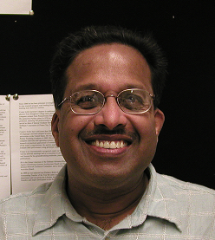

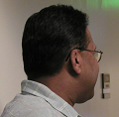
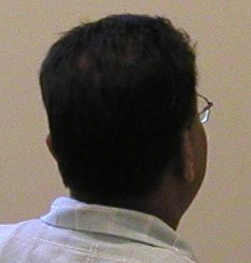

Evaporation Implemented as
Controlled Data Distortion
Distorted data reveal less, protects privacy
Examples:
  accurate data more and more distorted data
  250 N. Salisbury Street
  West Lafayette, IN
  250 N. Salisbury Street
  West Lafayette, IN
  [home address]
  765-123-4567
  [home phone]
  Salisbury Street
  West Lafayette, IN
  250 N. University Street
  West Lafayette, IN
  [office address]
  765-987-6543
  [office phone]
  somewhere in
  West Lafayette, IN
  P.O. Box 1234
  West Lafayette, IN
  [P.O. box]
  765-987-4321
  [office fax]

Slide 38
Evaporation Implemented as
Controlled Data Distortion
Distorted data reveal less, protects privacy
Examples:
  accurate data more and more distorted data
  250 N. Salisbury Street
  West Lafayette, IN
  250 N. Salisbury Street
  West Lafayette, IN
  [home address]
  765-123-4567
  [home phone]
  Salisbury Street
  West Lafayette, IN
  250 N. University Street
  West Lafayette, IN
  [office address]
  765-987-6543
  [office phone]
  somewhere in
  West Lafayette, IN
  P.O. Box 1234
  West Lafayette, IN
  [P.O. box]
  765-987-4321
  [office fax]

Slide 39
References
L. Lilien and B. Bhargava, ”A scheme for privacy-preserving data dissemination,” IEEE Transactions on Systems, Man and Cybernetics, Part A: Systems and Humans, Vol. 36(3), May 2006, pp. 503-506.
Bharat Bhargava, Leszek Lilien, Arnon Rosenthal, Marianne Winslett, “Pervasive Trust,” IEEE Intelligent Systems, Sept./Oct. 2004, pp.74-77
B. Bhargava and L. Lilien, “Private and Trusted Collaborations,” Secure Knowledge Management (SKM 2004): A Workshop, 2004.
B. Bhargava, C. Farkas, L. Lilien and F. Makedon, “Trust, Privacy, and Security. Summary of a Workshop Breakout Session at the National Science Foundation Information and Data Management (IDM) Workshop held in Seattle, Washington, September 14 - 16, 2003,” CERIAS Tech Report 2003-34, CERIAS, Purdue University, Nov. 2003.
http://www2.cs.washington.edu/nsf2003 or
https://www.cerias.purdue.edu/tools_and_resources/bibtex_archive/archive/2003-34.pdf
“Internet Security Glossary,” The Internet Society, Aug. 2004; www.faqs.org/rfcs/rfc2828.html.
“Sensor Nation: Special Report,” IEEE Spectrum, vol. 41, no. 7, 2004.
R. Khare and A. Rifkin, “Trust Management on the World Wide Web,” First Monday, vol. 3, no. 6, 1998; www.firstmonday.dk/issues/issue3_6/khare.
M. Richardson, R. Agrawal, and P. Domingos,“Trust Management for the Semantic Web,” Proc. 2nd Int’l Semantic Web Conf., LNCS 2870, Springer-Verlag, 2003, pp. 351–368.
P. Schiegg et al., “Supply Chain Management Systems—A Survey of the State of the Art,” Collaborative Systems for Production Management: Proc. 8th Int’l Conf. Advances in Production Management Systems (APMS 2002), IFIP Conf. Proc. 257, Kluwer, 2002.
N.C. Romano Jr. and J. Fjermestad, “Electronic Commerce Customer Relationship Management: A Research Agenda,” Information Technology and Management, vol. 4, nos. 2–3, 2003, pp. 233–258.

Slide 40
Bibliography for Related Work
AT&T Privacy Bird Tour: http://privacybird.com/tour/1 2 beta/tour.html. February 2004.
S. Bowers and L. Delcambre. The uni-level description: A uniform framework for representing information in multiple data models. ER 2003-Intl. Conf. on Conceptual Modeling, I.-Y. Song, et al. (Eds.), pp. 45–58, Chicago, Oct. 2003.
L. Cranor. P3P: Making privacy policies more useful. IEEE Security and Privacy, pp. 50–55, Nov./Dec. 2003.
M. Gensereth and R. Fikes. Knowledge Interchange Format. Tech. Rep. Logic-92-1, Stanford Univ., 1992.
A. Rakotonirainy. Trends and future of mobile computing. 10th Intl. Workshop on Database and Expert Systems Applications, Florence, Italy, Sept. 1999.
A. Rezgui, A. Bouguettaya, and M. Eltoweissy. Privacy on the Web: Facts, challenges, and solutions. IEEE Security and Privacy, pp. 40–49, Nov./Dec. 2003.
M. Spreitzer and A. Begel. More flexible data types. Proc. IEEE 8th Workshop on Enabling Technologies (WETICE ’99), pp. 319–324, Stanford, CA, June 1999.
C. Tschudin. Apoptosis - the programmed death of distributed services. In: J. Vitek and C. Jensen, eds., Secure Internet Programming. Springer-Verlag, 1999.

